Slide 1

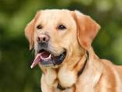
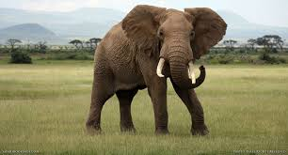
Image classification
Dog
Cat
Elephant

Slide 2
Classification steps
1.Compute interest points using SIFT on each training image.
2.Find the descriptors for those interest points.
3.Classify the image by using K-nearest neighbours algorithm.
4.Classify the image using labels.

Slide 3
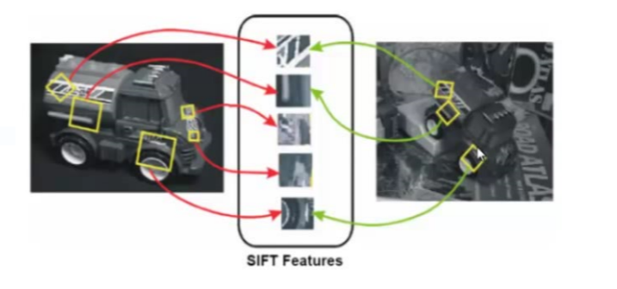
SIFT-KEY POINT EXTRACTION
Stands for scale invariant feature transform

Slide 4
STEPS FOR EXTRACTING KEY POINTS
Scale Space Peak Selection
--potential locations for finding features
Key point localization
--Accurately locating key feature points
Orientation Assignment
--Assigning orientation to key points
Key Point Descriptor
--Describing the key point as high dimensional vector

Slide 5
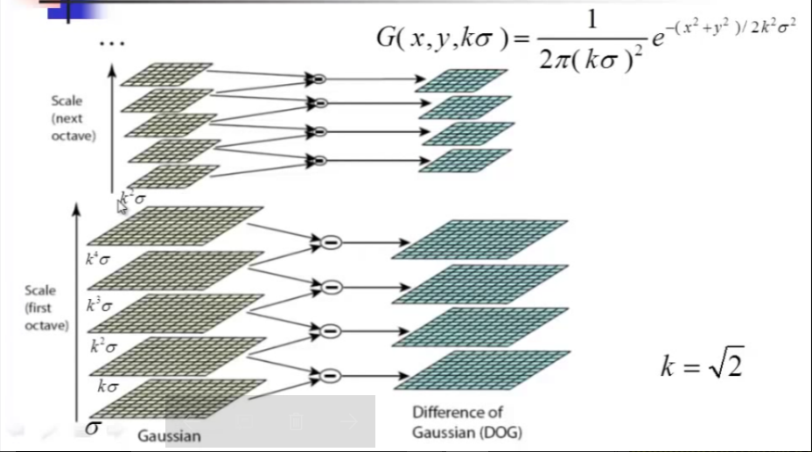
BUILDING A SCALE SPACE

Slide 6
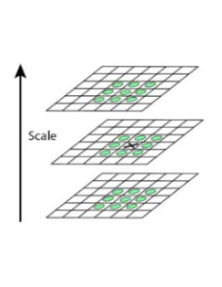
Scale Space Peak Detection
Compare a pixel (X) with 26 pixels in current and adjacent scales (GREEN CIRCLES).
Select a pixel (X) if larger/smaller than all 26 pixels.
Large number of extrema computationally expensive.
Detect the most suitable subset with a coarse sampling of scales

Slide 7
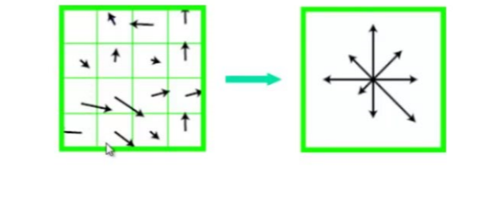
Orientation Assignment
Select the peak as the direction of key point
Introduce additional key points(same location) at local peaks(with in 80% of maximum peak) of histogram of different directions

Slide 8
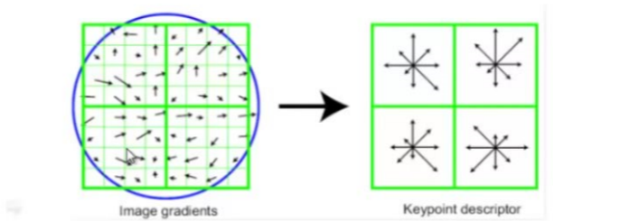
Extraction of local image descriptors at key points
Compute relevant orientation and magnitude in a 16X16 neighborhood at key point
From weighted histogram(8 bin) for 4X4 regions

Slide 9
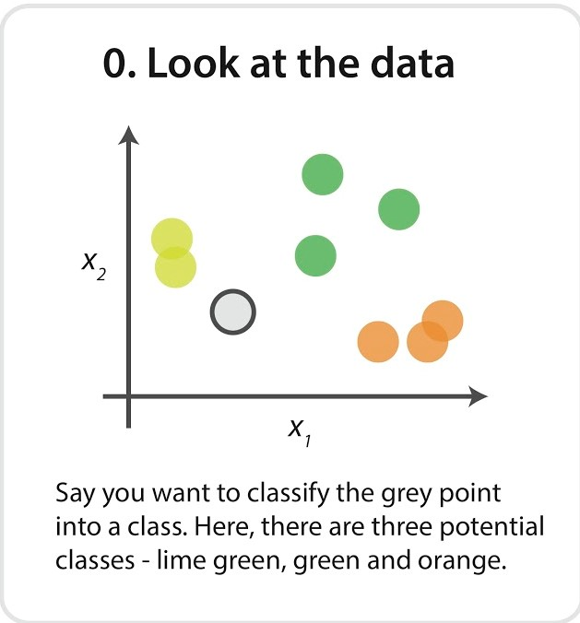
K nearest neighbors algorithm

Slide 10
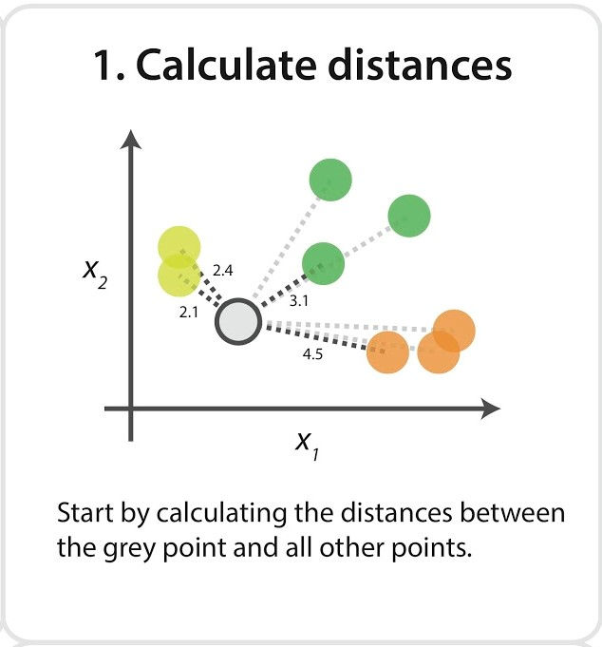
Euclidean Distance

Slide 11
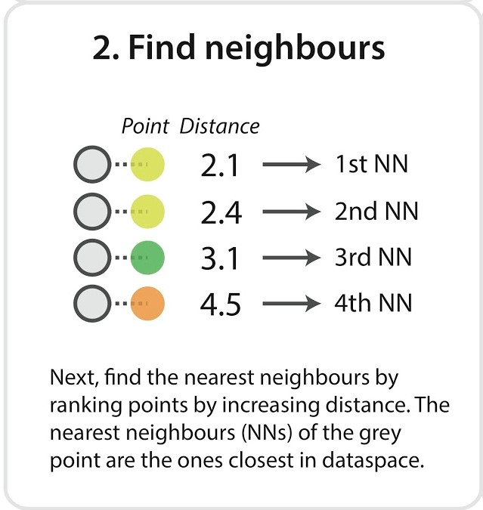

Slide 12
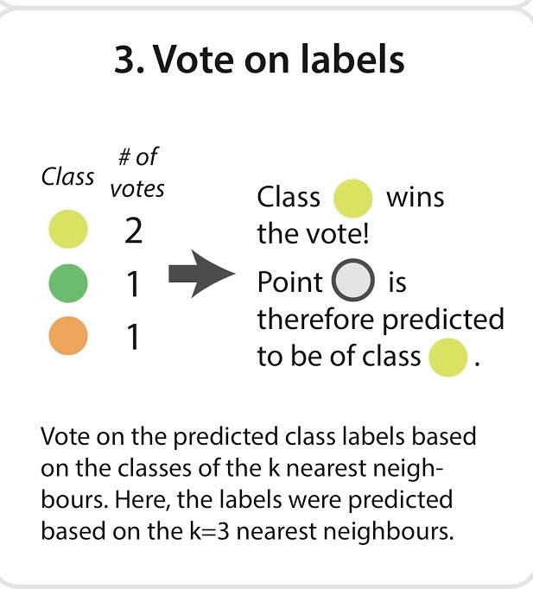

Slide 13
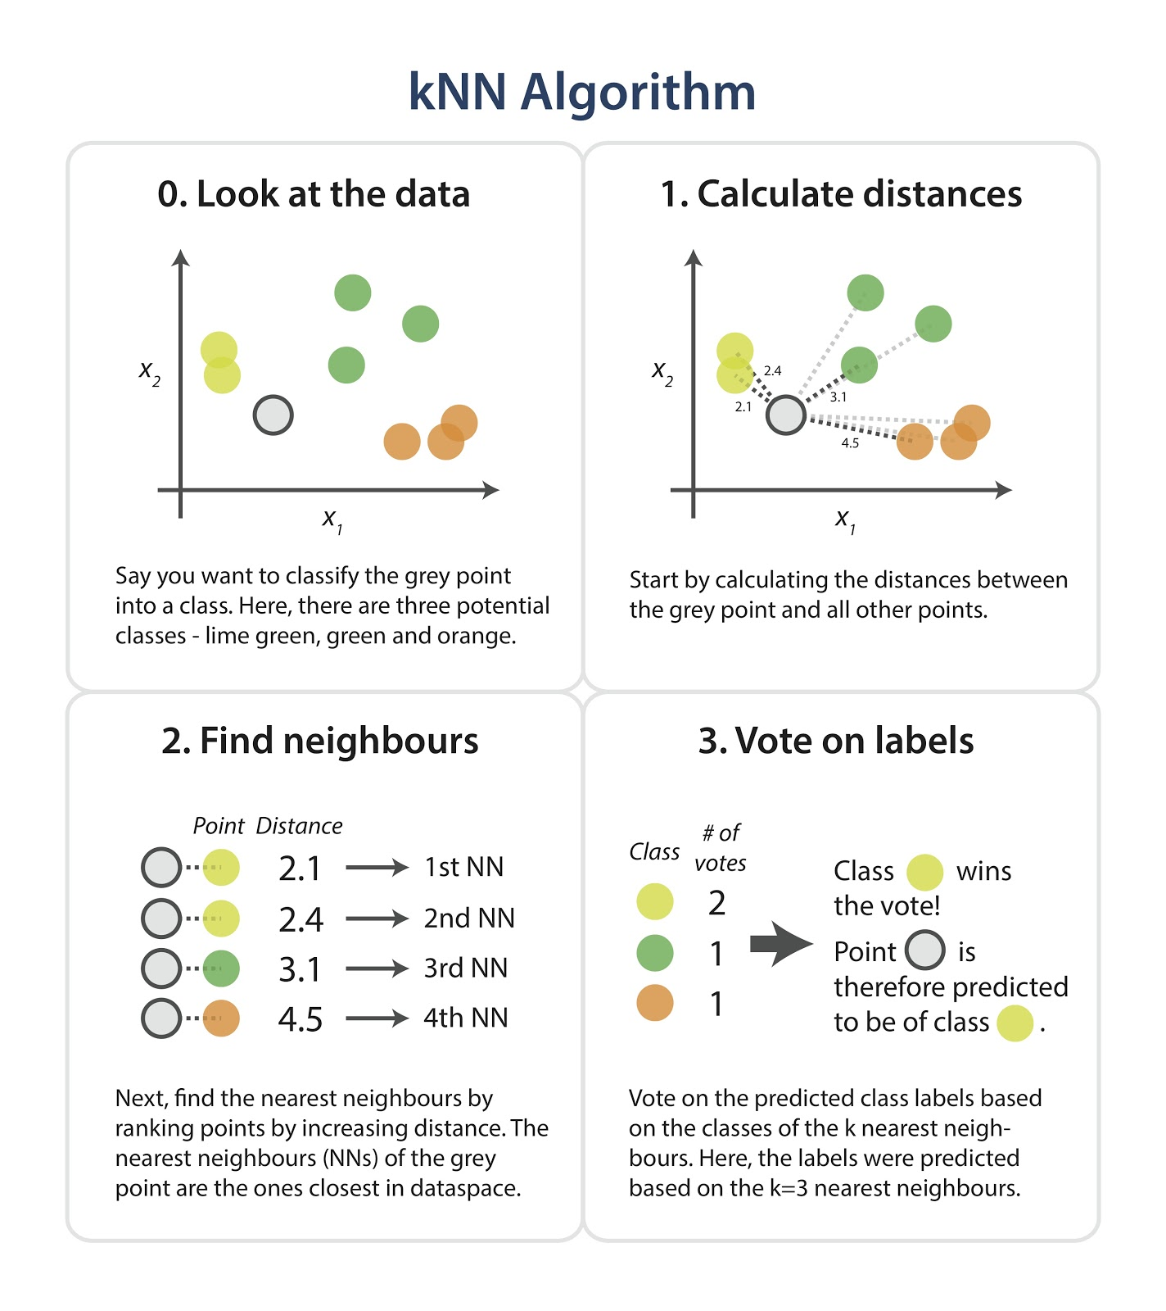

Slide 14

REFERENCE
D.LOWE.Distinctive image features from scale invariant key points, International Journal of Computer Vision 2004

